Slide 1

Scale and Rotation Invariant Image Search Framework
BTP Progress Review,
Department of Computer Science & Engineering, IIT Jodhpur
Ajeet Goyal – B14CS003
Ajeet Ujjwal – B14CS004
Guide: Dr. Chiranjoy Chattopadhyay

Slide 2
Objectives
Given a rotated or scaled floorplan image recognize it as the original image without correction.
To propose novel approaches to find scale and rotation invariant features in images
To implement the proposed techniques and compare the performances

Slide 3
Problem statement
Retrieval of Document Image Invariant to scale and orientation without correction
Input: Any Scaled or Rotated Image
Output: Similar Original images

Slide 4
Motivation
Orientation of floorplan images changes after scanning
To recognize these distorted and differently oriented and scaled images

Slide 5
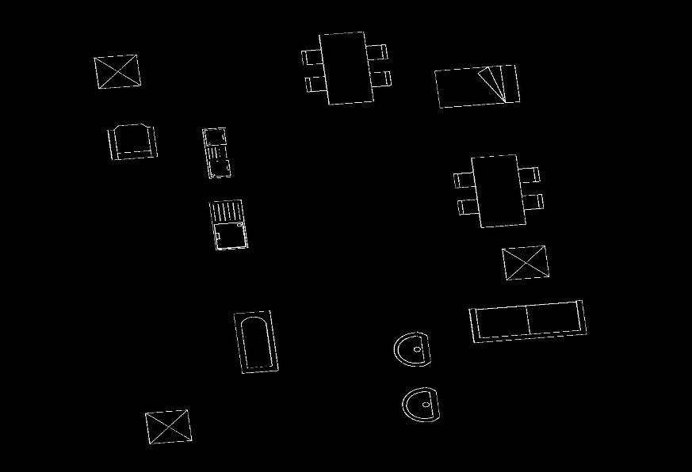
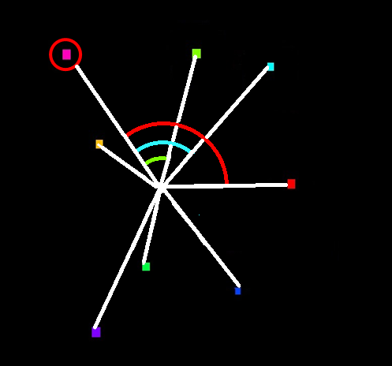
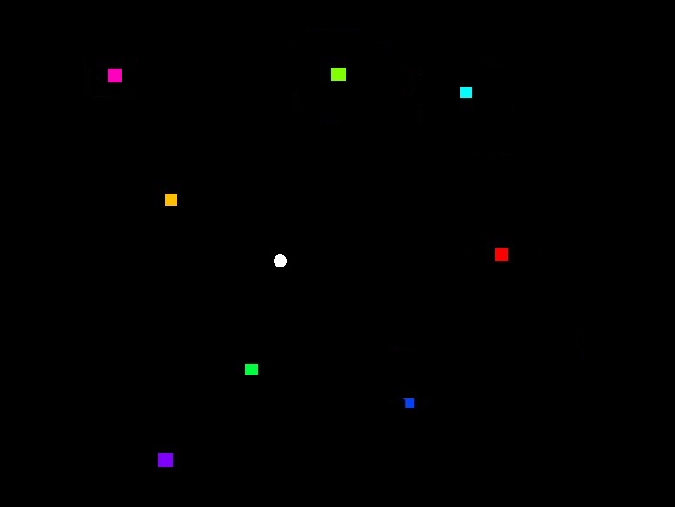
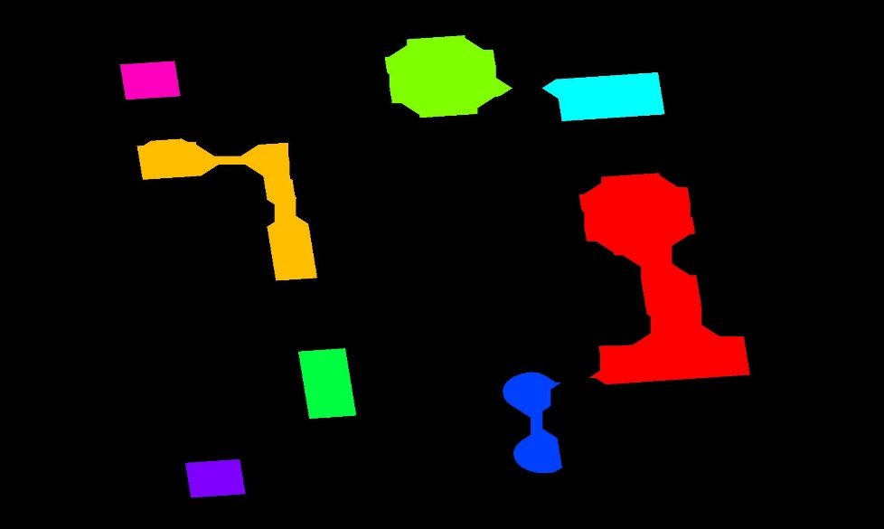
Approach 1

Slide 6
C₄
C₁
Global Centroid
A1
Centroids of connected components
A4
A3
C₃
C₂(largest distance from Global centroid)
D₁ D₂ D₃ D₄ are distances of C₁ C₂ C₃ C₄ from global centroid.
Angle A₂ = 0 (angle D₂ makes with itself)
ND₁, ND₂, ND₃ and ND₄ are normalized distances w.r.t D₁, D₂, D₃ and D₄ respectively.
Feature Vector: <ND₂ ND₃ ND₄ ND₁ 0 A₃ A₄ A₁>

Slide 7
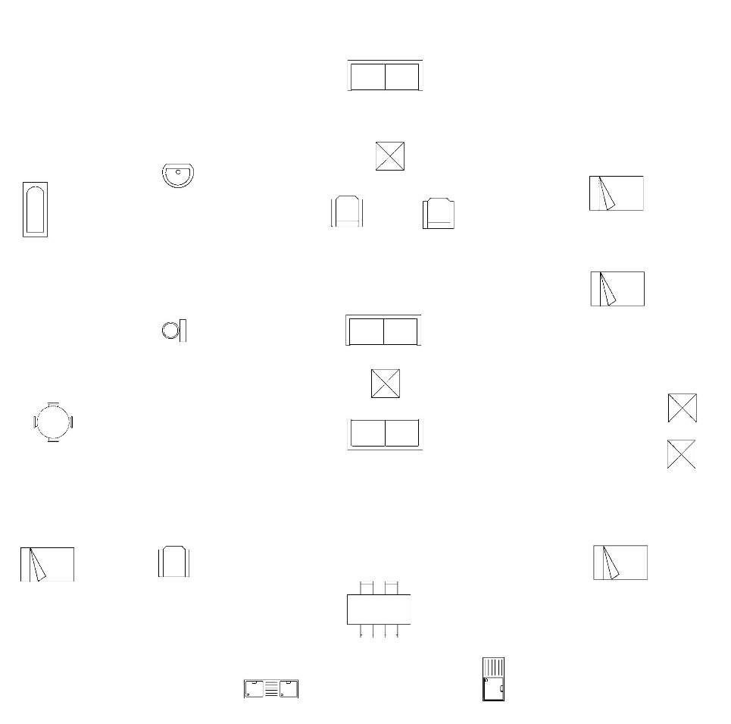
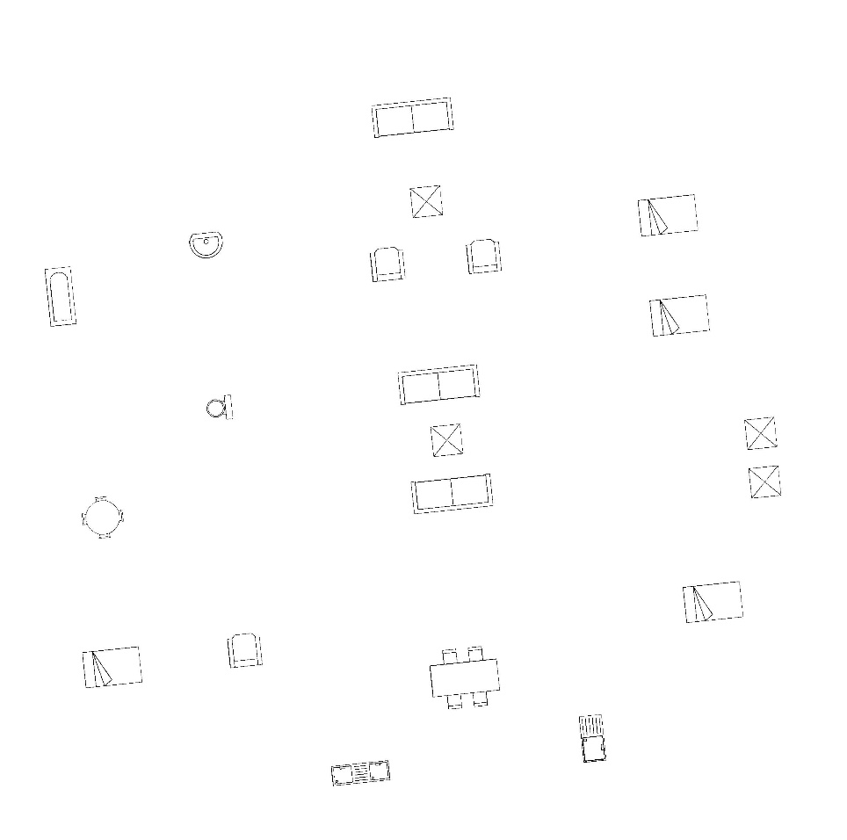
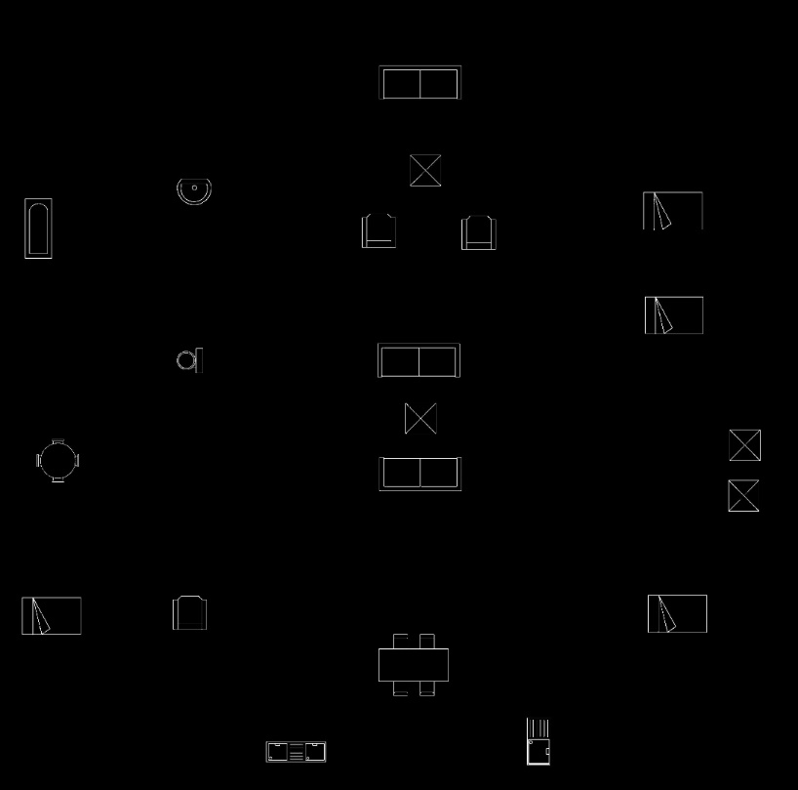
Problem
Original Image: 50 connected components
Original Image rotated by 6 degree:
142 connected components

Slide 8
Solution
Preprocessing of Image:
Binarize the floorplan image and remove the boundary (wall, door, window)
Close the image with disc as a structuring element
Filling the holes in all connected components
Removing all small connected components

Slide 9
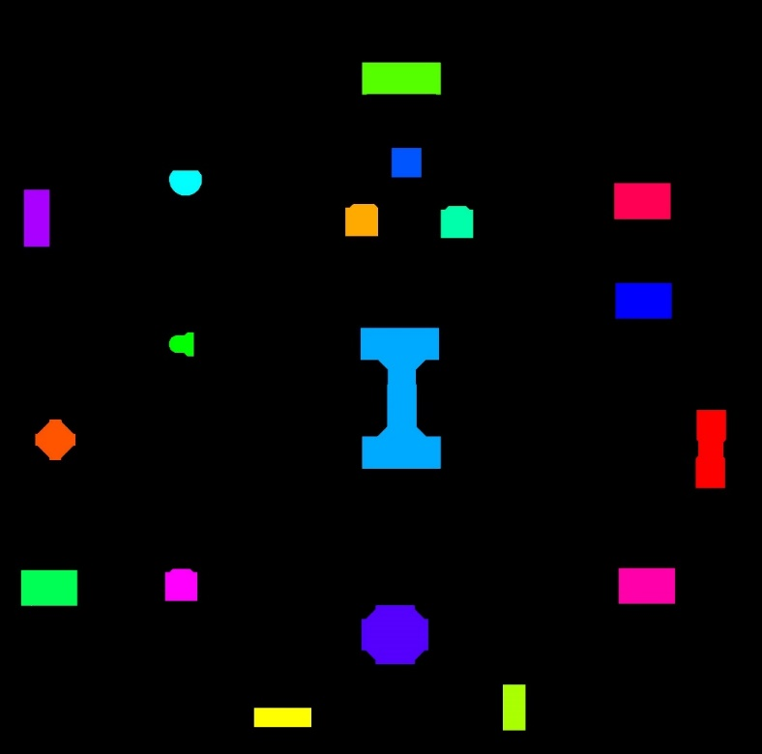
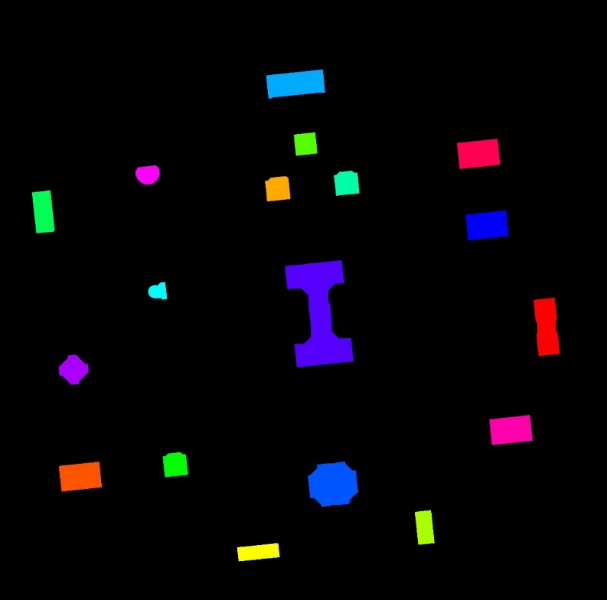
After Preprocessing
Original Image: 18 connected components
Rotated Image: 18 connected components

Slide 10
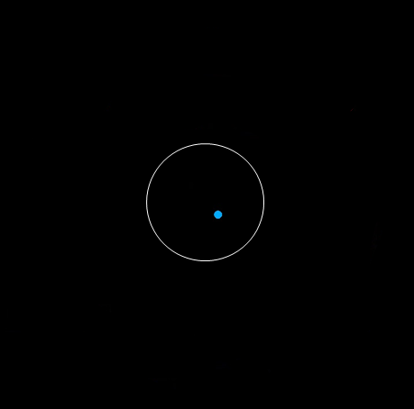
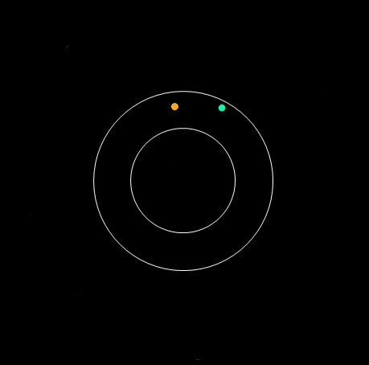
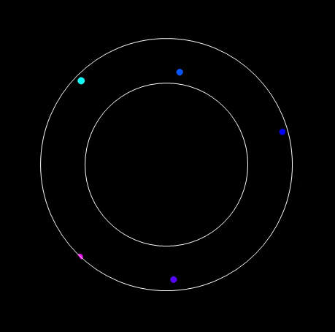
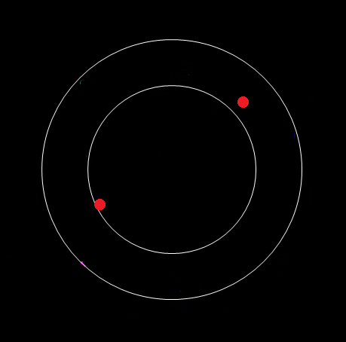

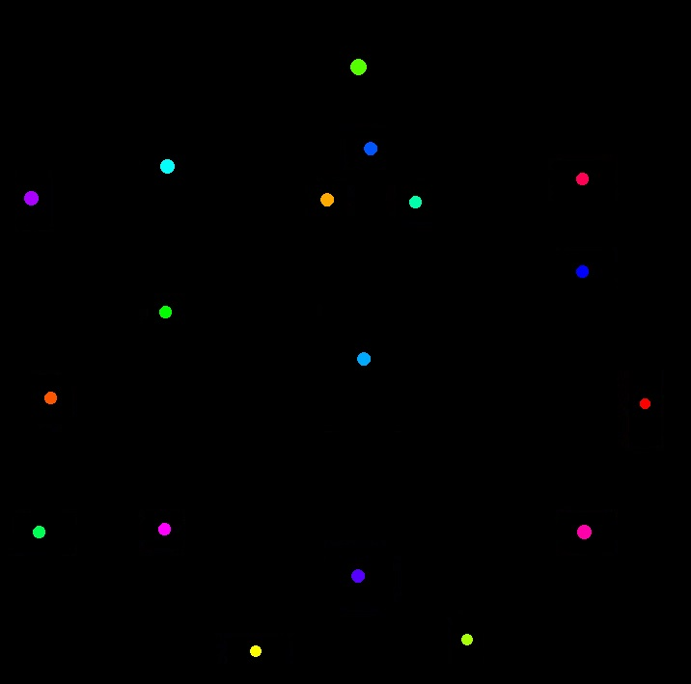
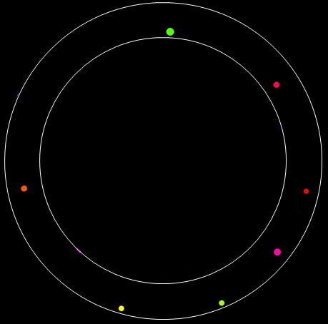
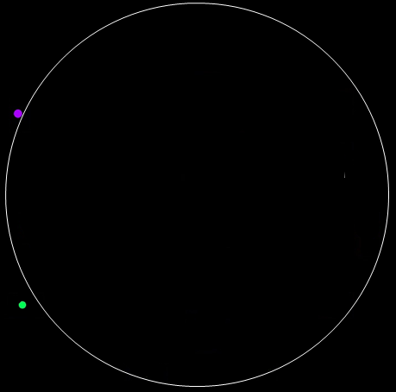
Approach 2

Slide 11
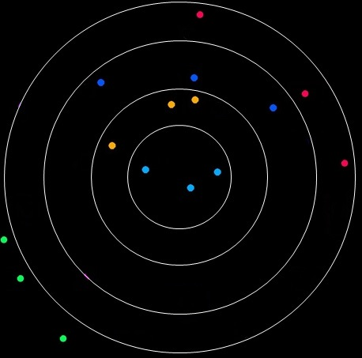
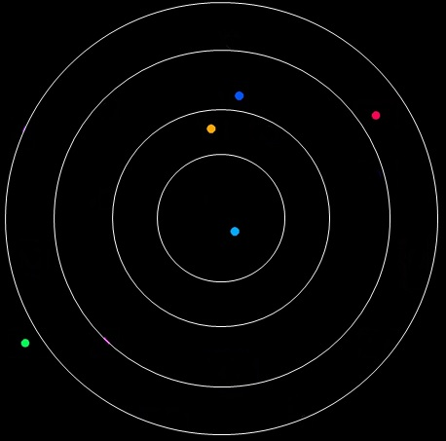
P₄₂
G₃
G₄
P₃₂
G₂
P₂₁
P₃₁
P₂₂
P₁₁
P₄₁
G₁
P₁₂
P₅₁
G5`
G₅
P₅₂
We get three sets of points:
Set1: {G₁, G₂, G₃, G₄, G₅}
Set2: {P₁₁, P₂₁, P₃₁, P₄₁, P₅₁} – Cluster points closer to corresponding global centroid
Set3: {P₁₂, P₂₂, P₃₂, P₄₂, P₅₂} – Cluster points farther to corresponding global centroid
Angle Vector for Set1: [ ∠G₅G₄G₃, ∠G₅G₄G₂, ∠G₅G₄G₁, ∠G₅G₃G₂, ∠G₅G₃G₁,
∠G₅G₂G₁, ∠G₄G₃G₂, ∠G₄G₃G₁, ∠G₄G₂G₁, ∠G₃G₂G₁ ]
Feature vector: [ <set1 angle vector>, <set2 angle vector>, <set3 angle vector> ]

Slide 12
Comparison of Feature Vectors
Case 1: If both vectors have same length.
function PercentMatch:
input: vector1, vector2 & threshold
output: Percentage similarity
n = length(vector1);
matched = 0;
for i = 1 to n
if abs(vector1[i] - vector2[i]) <= threshold then
matched++;
return matched * 100 / n;
Example:
threshold = 0.1
vector1 = [ 1 2 3 4 5 ]
vector2 = [ 1.1 2.3 3 3.9 5.1 ]
PercentMatch = 4 * 100 / 5 = 80 %

Slide 13
Comparison of Feature Vectors
Case 2: If both vectors have different length.
function PercentMatch:
input: vector1, vector2 & threshold (let vector1 be the smaller one)
output: Percentage similarity
s = length(vector1);
b = length(vector2);
matched = 0;
bs = 1; // starting index of vector2
for i = 1 to s
for j = bs to b
if abs(vector1[ i ] - vector2[ j ]) <= threshold then
matched++;
bs = j + 1;
break;
return matched * 100 / b;
Example:
threshold = 0.1
vector1 = [ 1 2 3 4 5 ]
vector2 = [ 1.1 2.3 3 4.5 3.9 5.1 ]
PercentMatch = 4 * 100 / 6 = 66.67 %

Slide 14
Results
No of extra components | Approach 1 | Approach 2
0 | 98.33 % | 97.50 %
1 | 94.58 % | 47.08 %
2 | 79.16 % | 42.91 %
Training Dataset / No of Images used for training = 480
Total Input Dataset / No of Input images used for checking recognition = 720

Slide 15
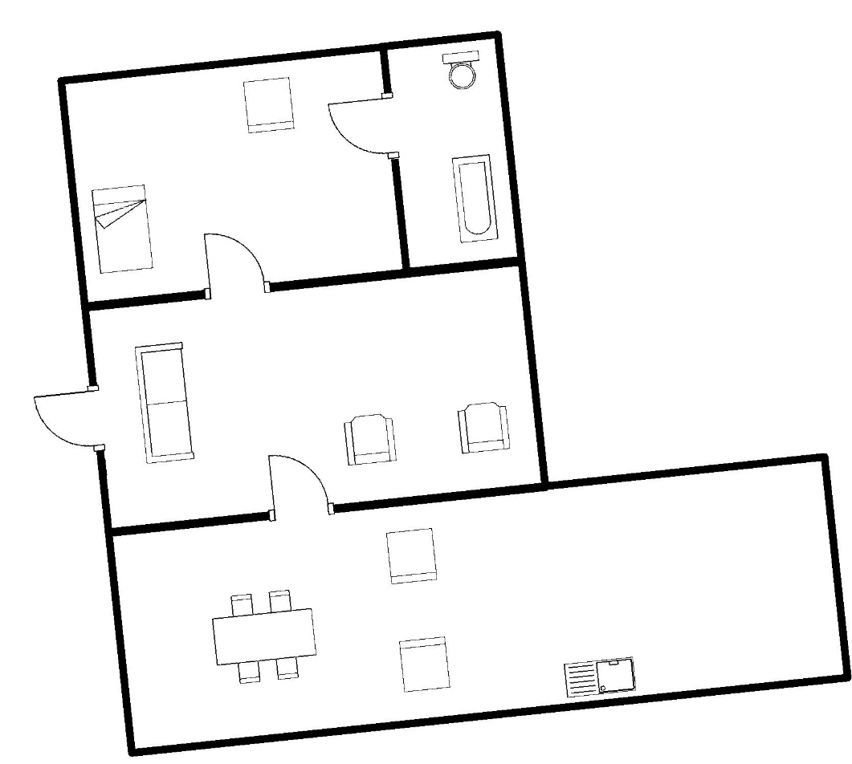
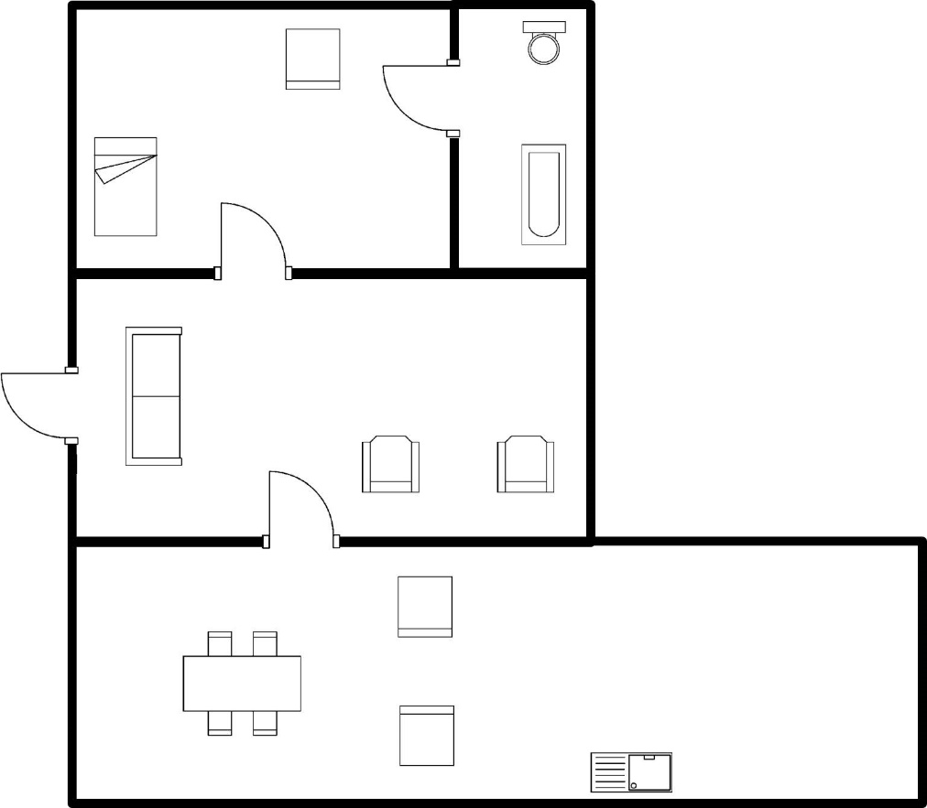
Results
Input Image
Output Image

Slide 16
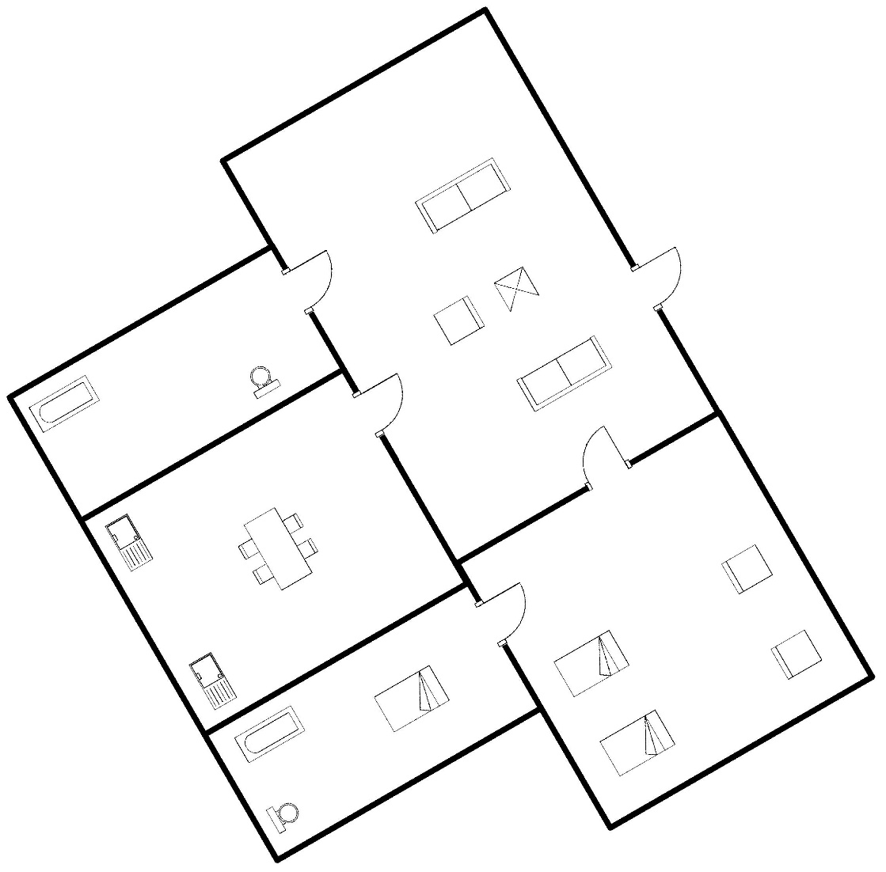
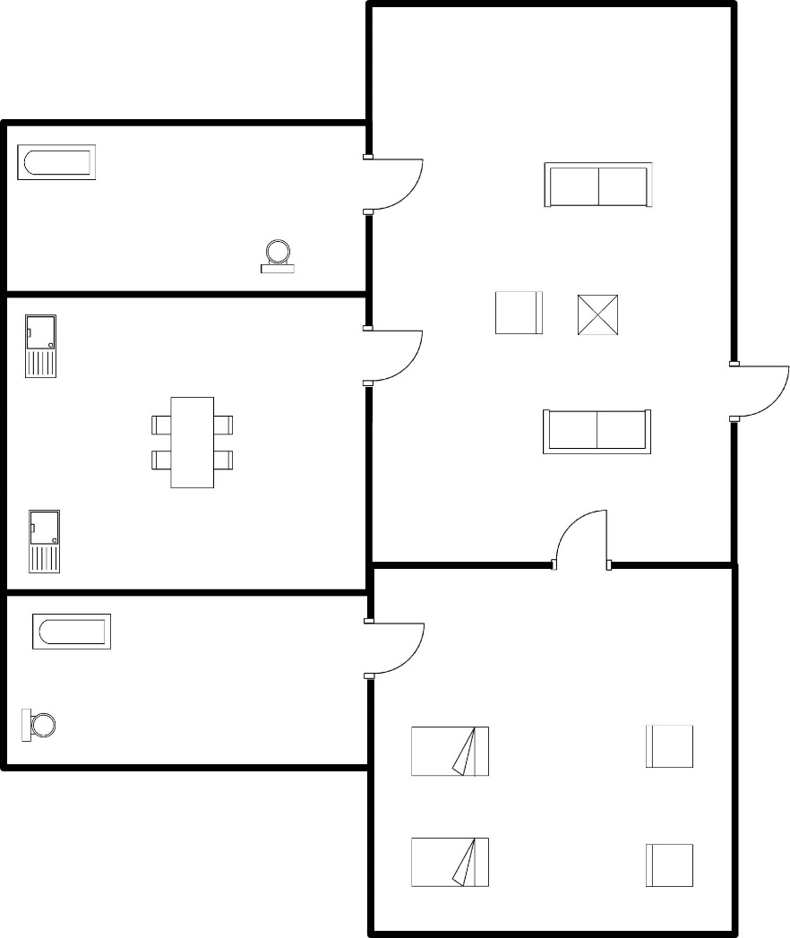
Results
Input Image (1 extra component)
Output Image

Slide 17
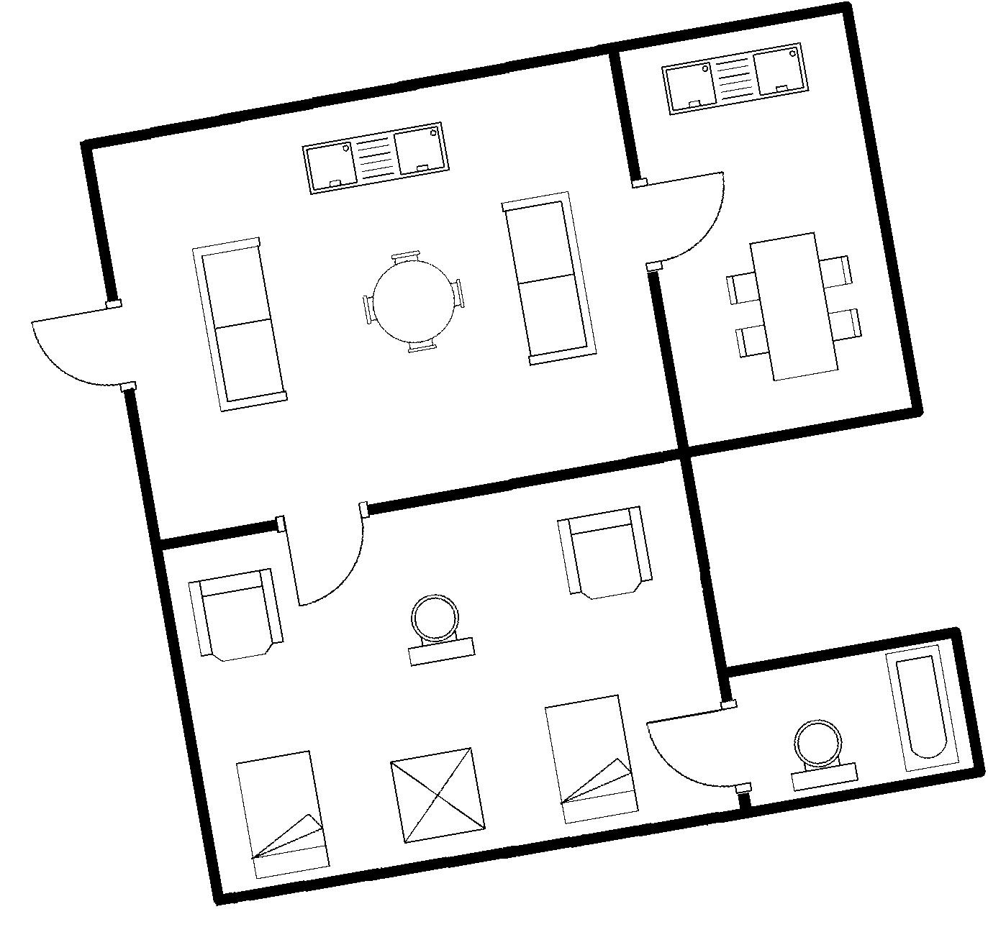
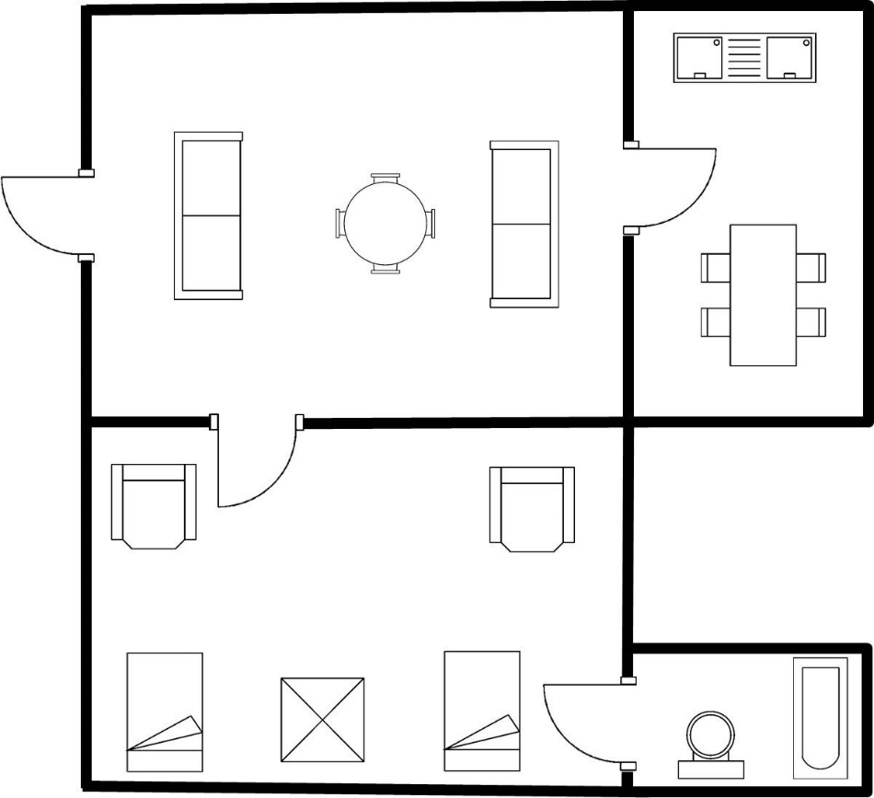
Results
Input Image (2 extra components)
Output Image

Slide 18
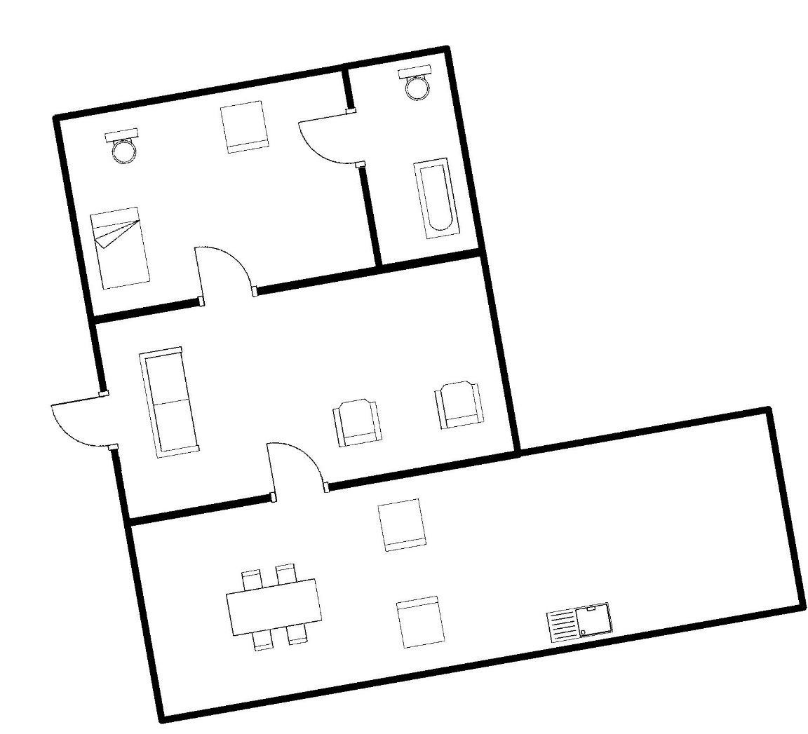
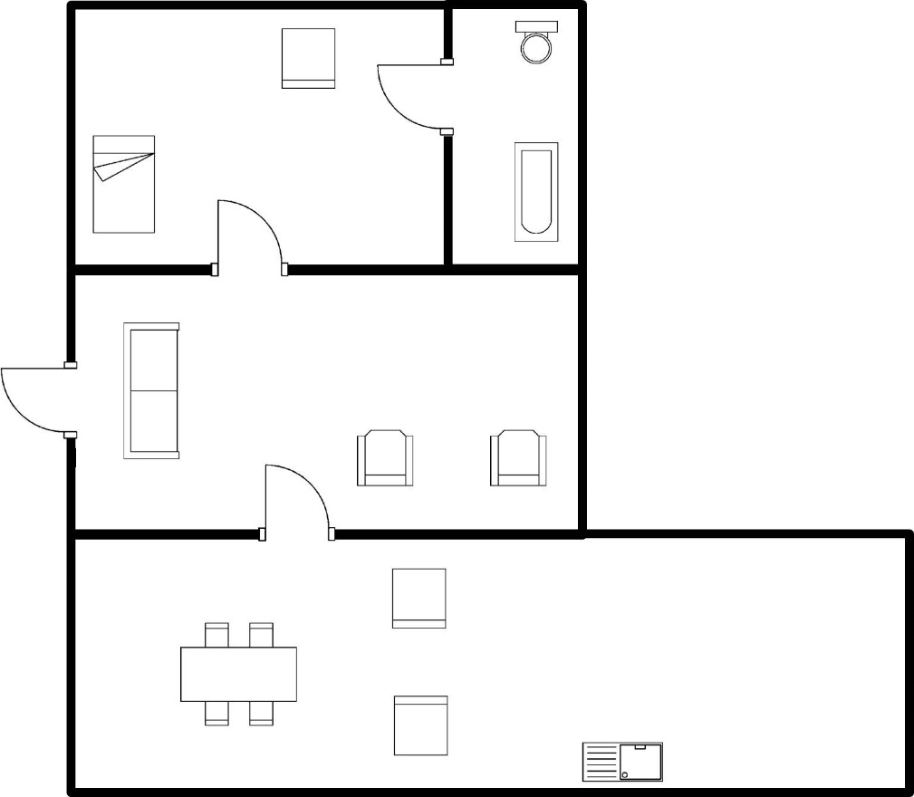
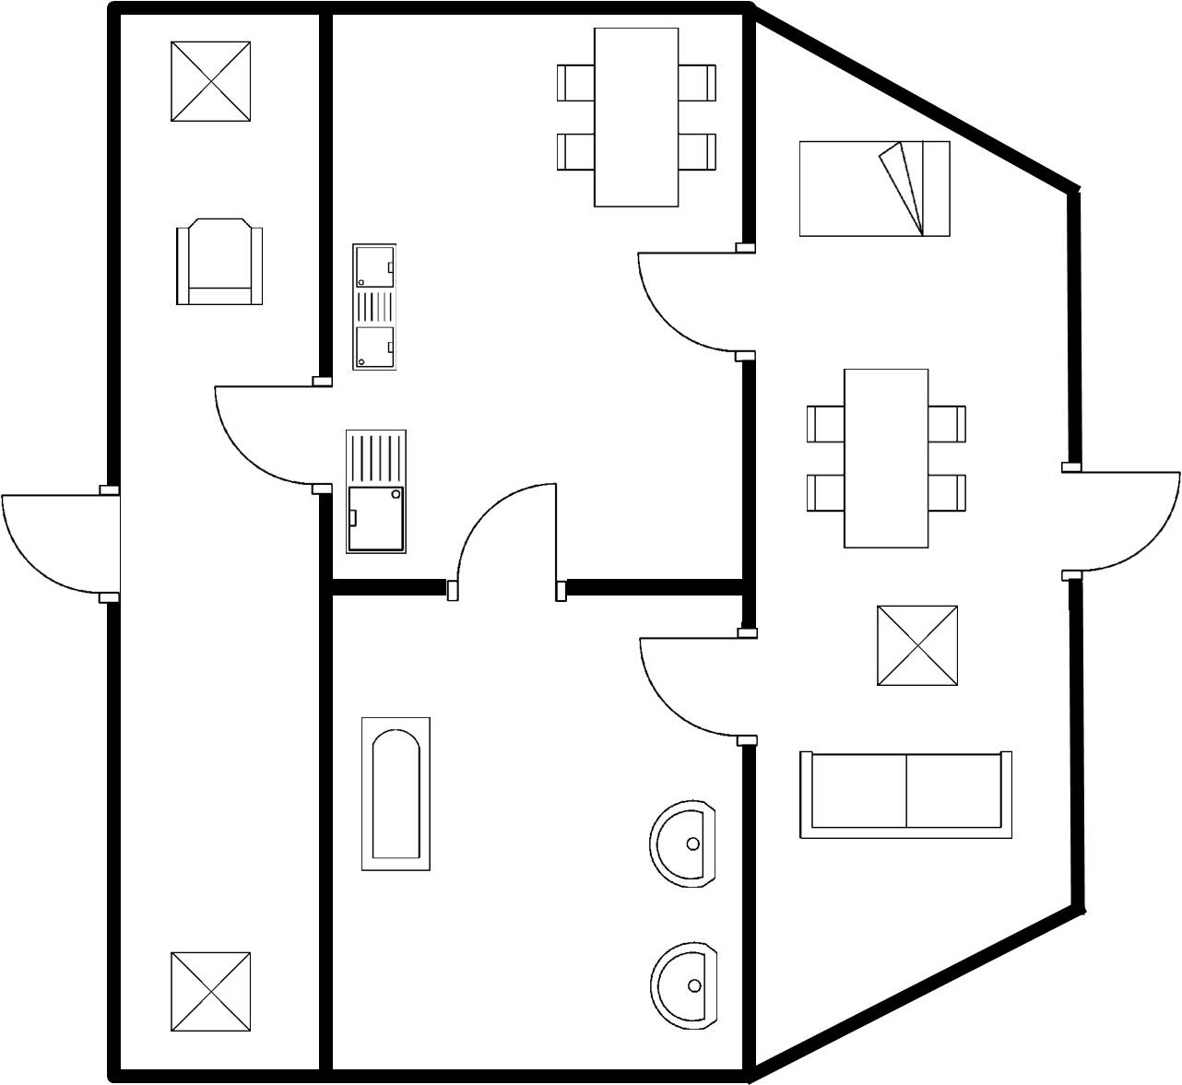
Failure
Input Image (1 extra components)
Output Image
Recognized Successfully with Approach 1
Recognized Incorrectly with Approach 2

Slide 19
Future Work
Limitation of existing work: It works only on a single property (centroid) of connected components in the image, therefore two completely different images having same orientation of components are recognized as same.
Other properties of connected components like size and shape also need to be considered.
So future work includes checking similarity of individual components of image on basis of multiple properties like centroid, shape, size etc.

Slide 20
References
U. Pal and N. Tripathy, "A contour distance-based approach for multi-oriented and multi-sized character recognition", Sadhana, vol. 34, no. 5, pp. 755-765, 2009.
N. Tripathi, T. Chakraborti, M. Nasipuri and U. Pal, “A scale and rotation invariant scheme for multi-oriented character recognition”, in Proceedings of 23rd International Conference on Pattern Recognition, 2016, pp. 4041-4046.

Slide 21
Thank you

